Slide 1
Lecture 5
Work Breakdown Structure
Engr. Rahemeen Khan
Sr. Lecturer
Software Engineering Department

Slide 2
Work Breakdown Structure (WBS)
A Work Breakdown Structure includes dividing a large and complex project into simpler, manageable, and independent tasks.
The root of this tree (structure) is labeled by the Project name itself. For constructing a work breakdown structure, each node is recursively decomposed into smaller sub-activities, until at the leaf level, the activities become undividable and independent.
It follows a Top-Down approach.

Slide 3
Work Breakdown Structure (WBS)
Levels:
The depth of the WBS is dependent upon the size and complexity of the project and the level of detail needed to plan and manage it.
The 100% Rule:
This rule states that the WBS includes 100% of the work defined by the project scope and captures all work deliverables to be completed, including project management.
The rule applies to all levels within the hierarchy.

Slide 4
Different types of work breakdown structures
Here are some work breakdown structure examples. You can use any of these to outline your WBS.
WBS spreadsheet: You can structure your WBS efficiently in a spreadsheet, noting the different phases, tasks, or deliverables in the columns and rows.
WBS flowchart: You can structure your WBS in a diagrammatic workflow. Most WBS examples and templates you may find are flowcharts.
WBS list: You can structure your WBS as a simple list of tasks or deliverables and subtasks. This is the most straightforward approach to make a WBS.
WBS Gantt chart: You can structure your WBS as a Gantt chart that represents both a spreadsheet and a timeline. With a Gantt chart-structured WBS.

Slide 5


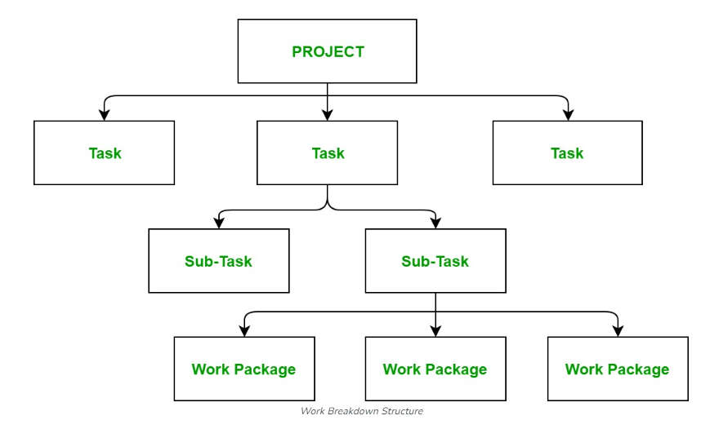

Steps Work Breakdown Structure:
Step 1: Identify the major activities of the project.
Step 2: Identify the sub-activities of the major activities.
Step 3: Repeat till undividable, simple, and independent activities are created.
Level 1
Level 1
Level 1
Level 1

Slide 6
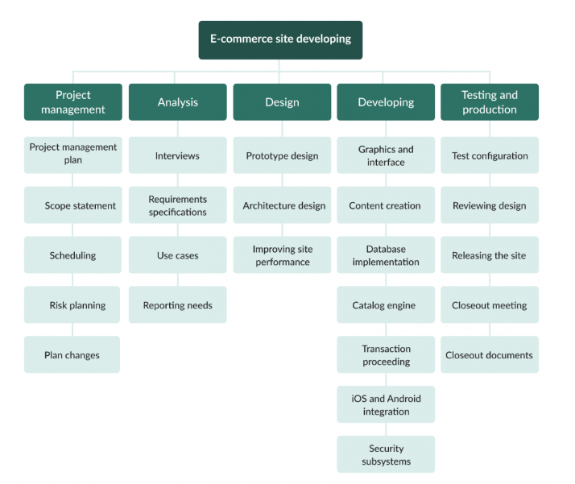
WBS Example for software development

Slide 7
As you see, this result-oriented tree work breakdown structure example of a software project focuses on the project management, analysis, designing, developing, and testing stages.
Project management. The first stage of our work breakdown structure for software project example includes planning, defining scope, scheduling, risk management, and work with possible plan changes.
Analysis. At this stage, project teams conduct required interviews, work on requirements specifications, and prepare use cases.
Design is one of the most essential parts of our software development work breakdown structure example. Here, you should care about the prototype design, architecture design, and site performance improvements.
Developing. This is typically one of the most active phases of software development, so you will need to thoroughly work on developing the new e-commerce site and care about all the details, meaning graphics and interface, content creation, database implementation, catalog engine, transaction processing, iOS and Android integration, security, and other important issues.
Testing and production are what end the process. This is when test configuration, reviewing design, releasing the site, closeout meetings, and preparing closeout documents happen.

Slide 8
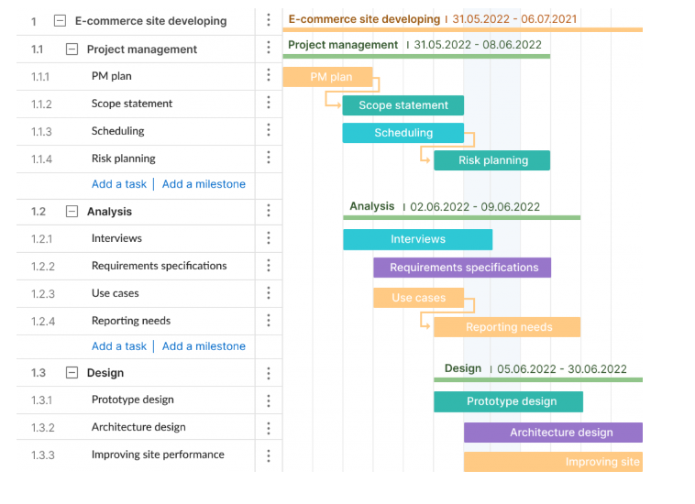
Look at how convenient the tasks and subtasks are displayed on a Gantt chart

Slide 9

Work Breakdown Structure (WBS)
Very important key points to keep in mind while developing a WBS:
The WBS is created with the help of the team.
The first level is completed before the project is broken down further.
Each level of the WBS is a smaller piece of the level above.
The WBS includes only deliverables that are really needed.
Deliverables not included in the WBS are not part of the project.

Slide 10

Work Breakdown Structure (WBS)
Very important…work packages are reached when they include deliverables that:
Can be realistically and confidently estimated.
Can be completed quickly.
Can be completed without interruption (in other words, without the need of more information).
May be outsourced or contracted out.

Slide 11

BENEFITS:
It provides the project team members with an understanding of where their pieces fit into the overall project management plan.
It facilitates communication and cooperation among team members.
It helps prevent changes.
It provides a basis for estimating staff, cost, and time.

Slide 12

Make sure you read this information twice:
Under a professional project management methodology, every single project you manage must have a WBS.
You cannot afford to misunderstand this important project management tool.
Why?
Without it, the project will take longer, elements will slip through the cracks, and the project will be negatively impacted.

Slide 13
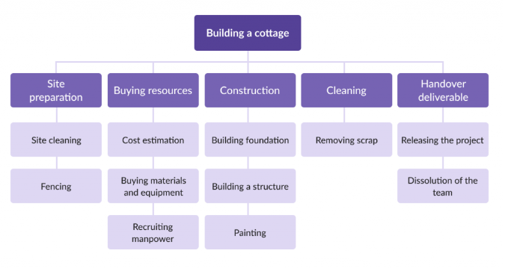
Example:
Work breakdown structure construction project example

Slide 14
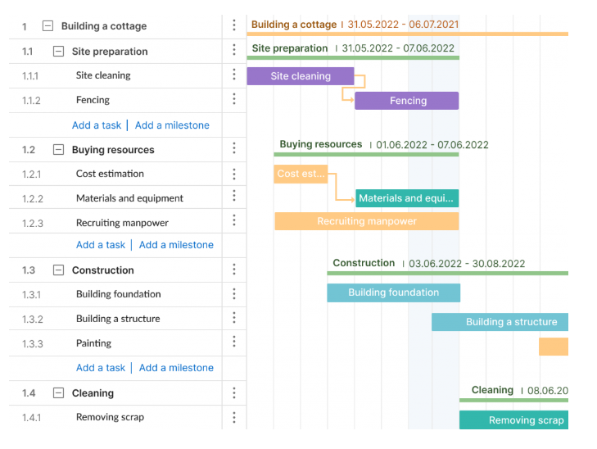
Now look at how a WBS can be visualized in GanttPRO.

Slide 15
Example of a work breakdown structure for opening a restaurant??

Slide 16
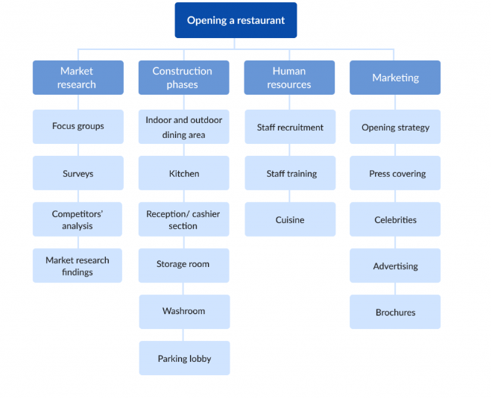

Slide 17
In summary:
Most commonly, the project title goes at the top of the WBS.
The first level is normally the same as the project life cycle.
The following levels break the project into smaller pieces.
This is a top – down effort to decompose the deliverables and
the work required to produce them.
The complete scope of the project (product, project, and management
efforts) are included.

Slide 18
Q/A

